Slide 1

Lost and Found
Aloïs Borgognon
Henri Keopraseuth
Samuel Nguyen

Slide 2

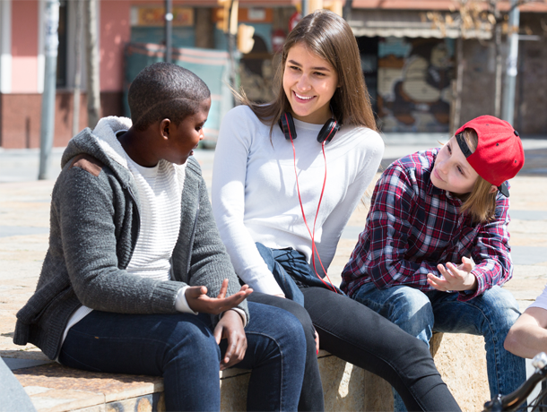

Nowadays when you lose something on the campus...
You check on Facebook if someone has found it
You ask your friends about it
You pray to see it again someday

Slide 3

Our
Idea
Help students, who have lost something, as efficiently as possible

Slide 4
An application that...
Makes looking for lost objects easier
Changes the way one returns lost objects

Slide 5
3 Concepts
Each member’s take on how the app should look like

Slide 6
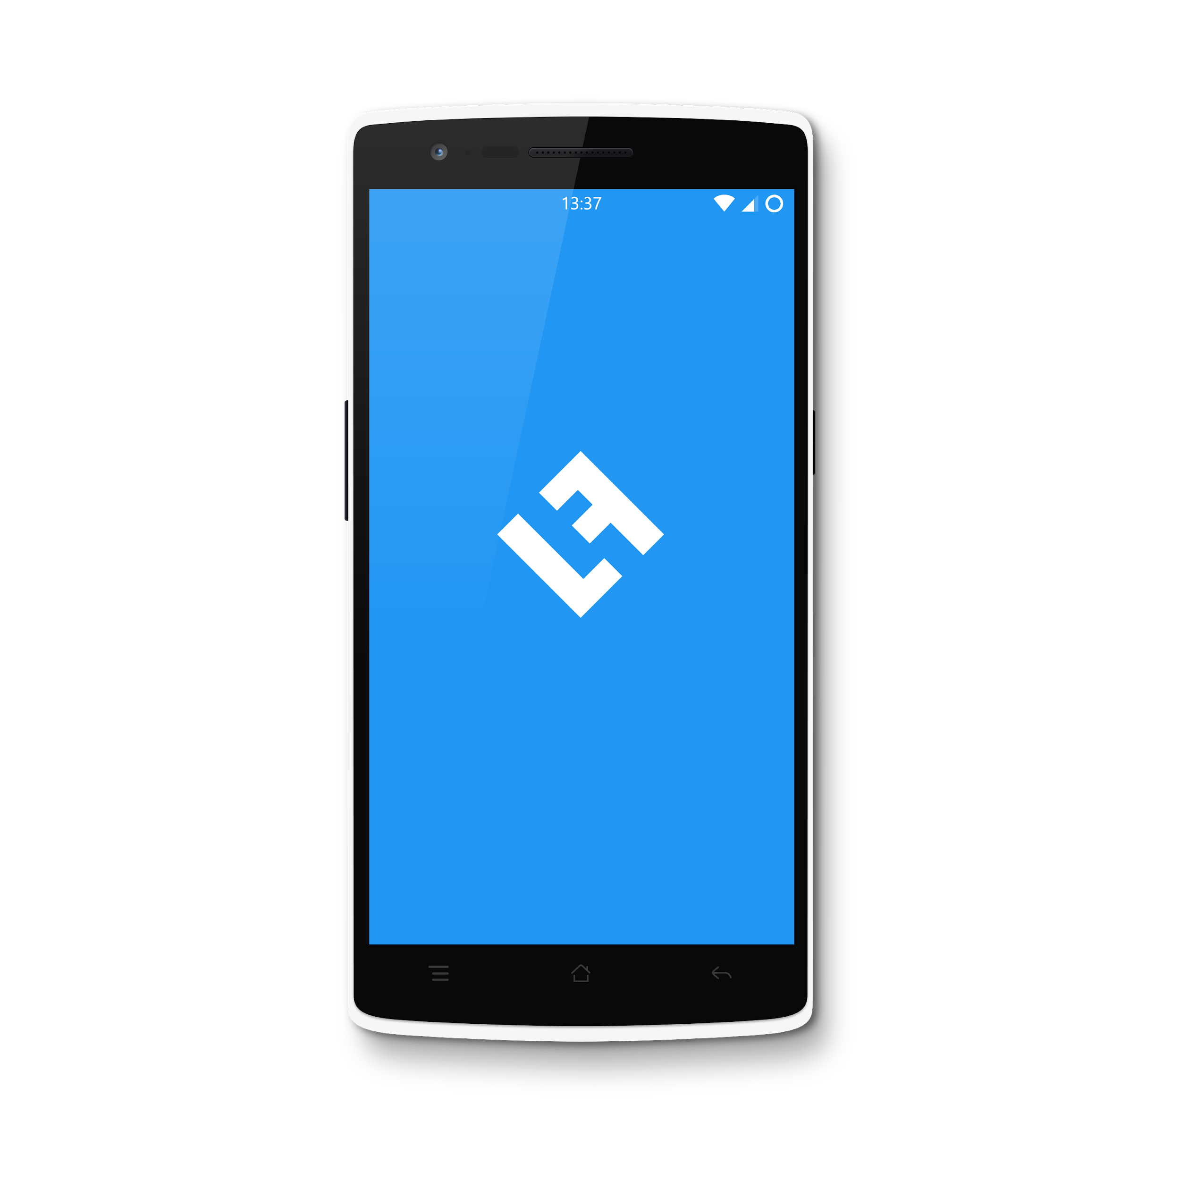
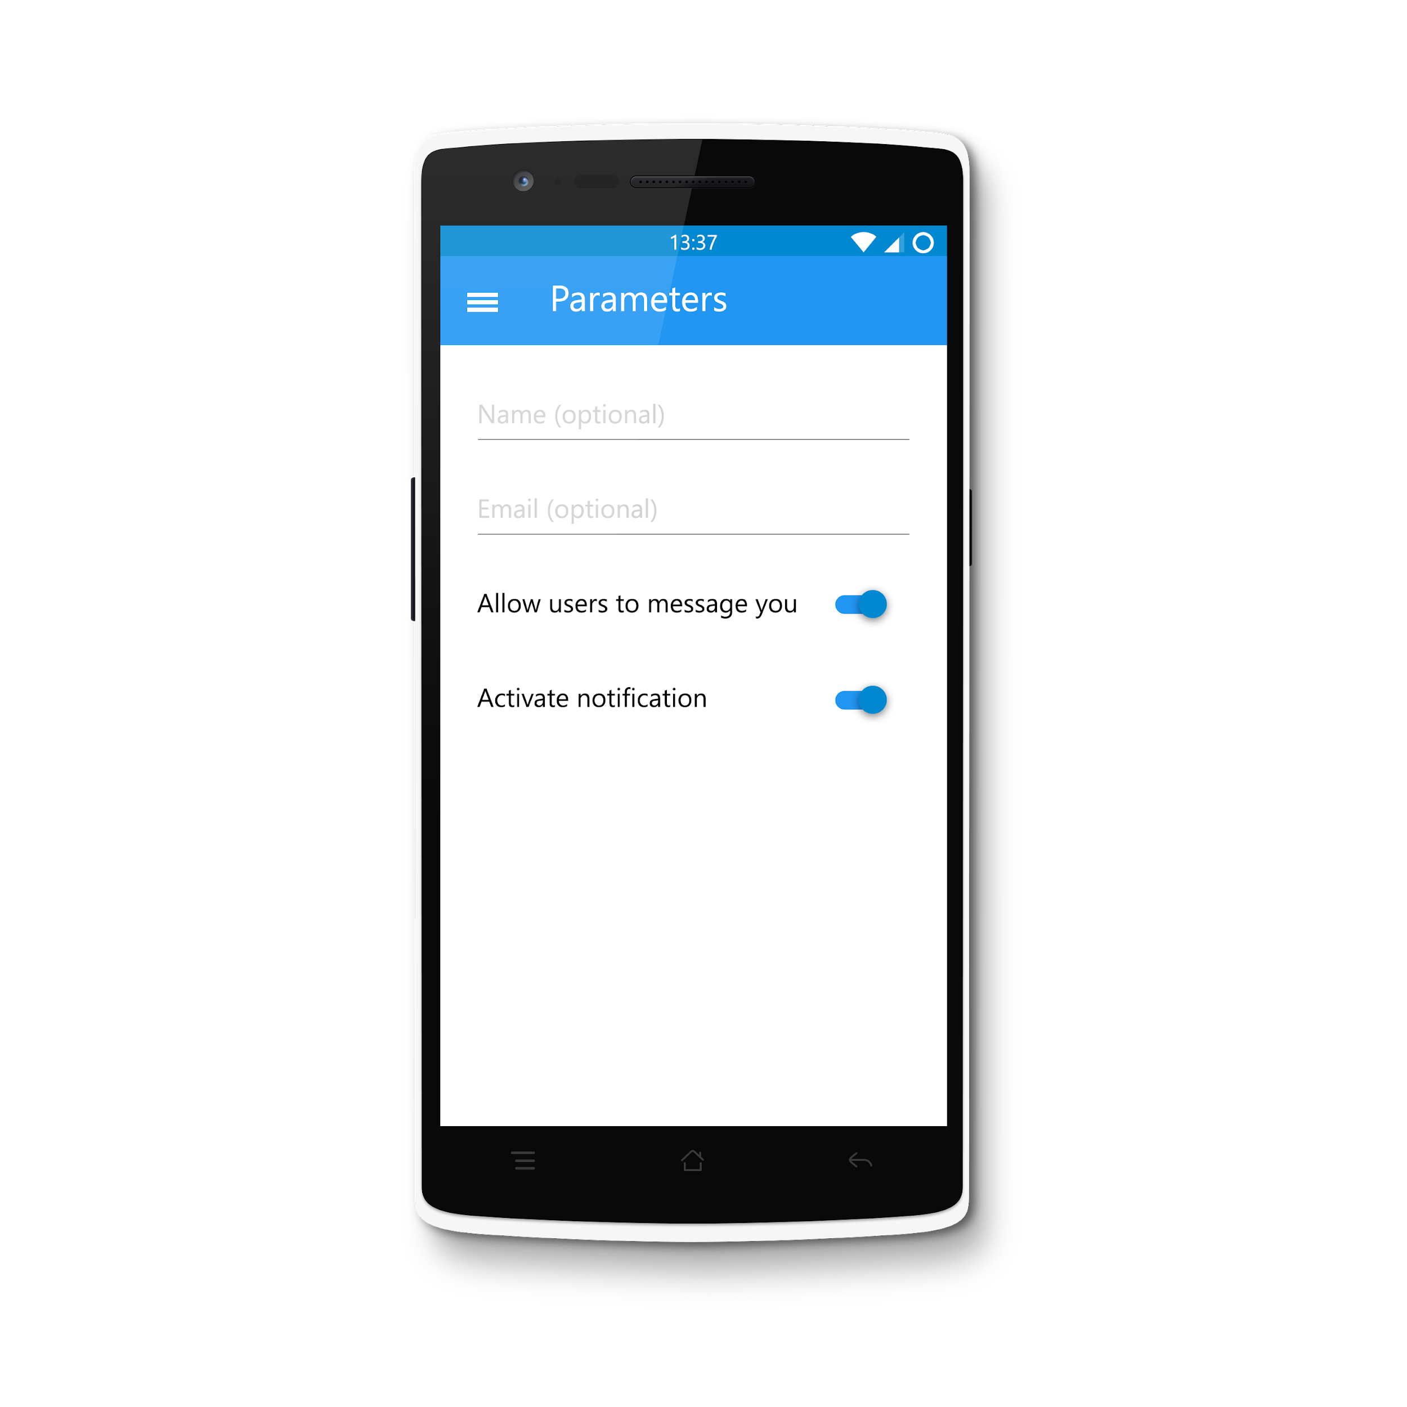
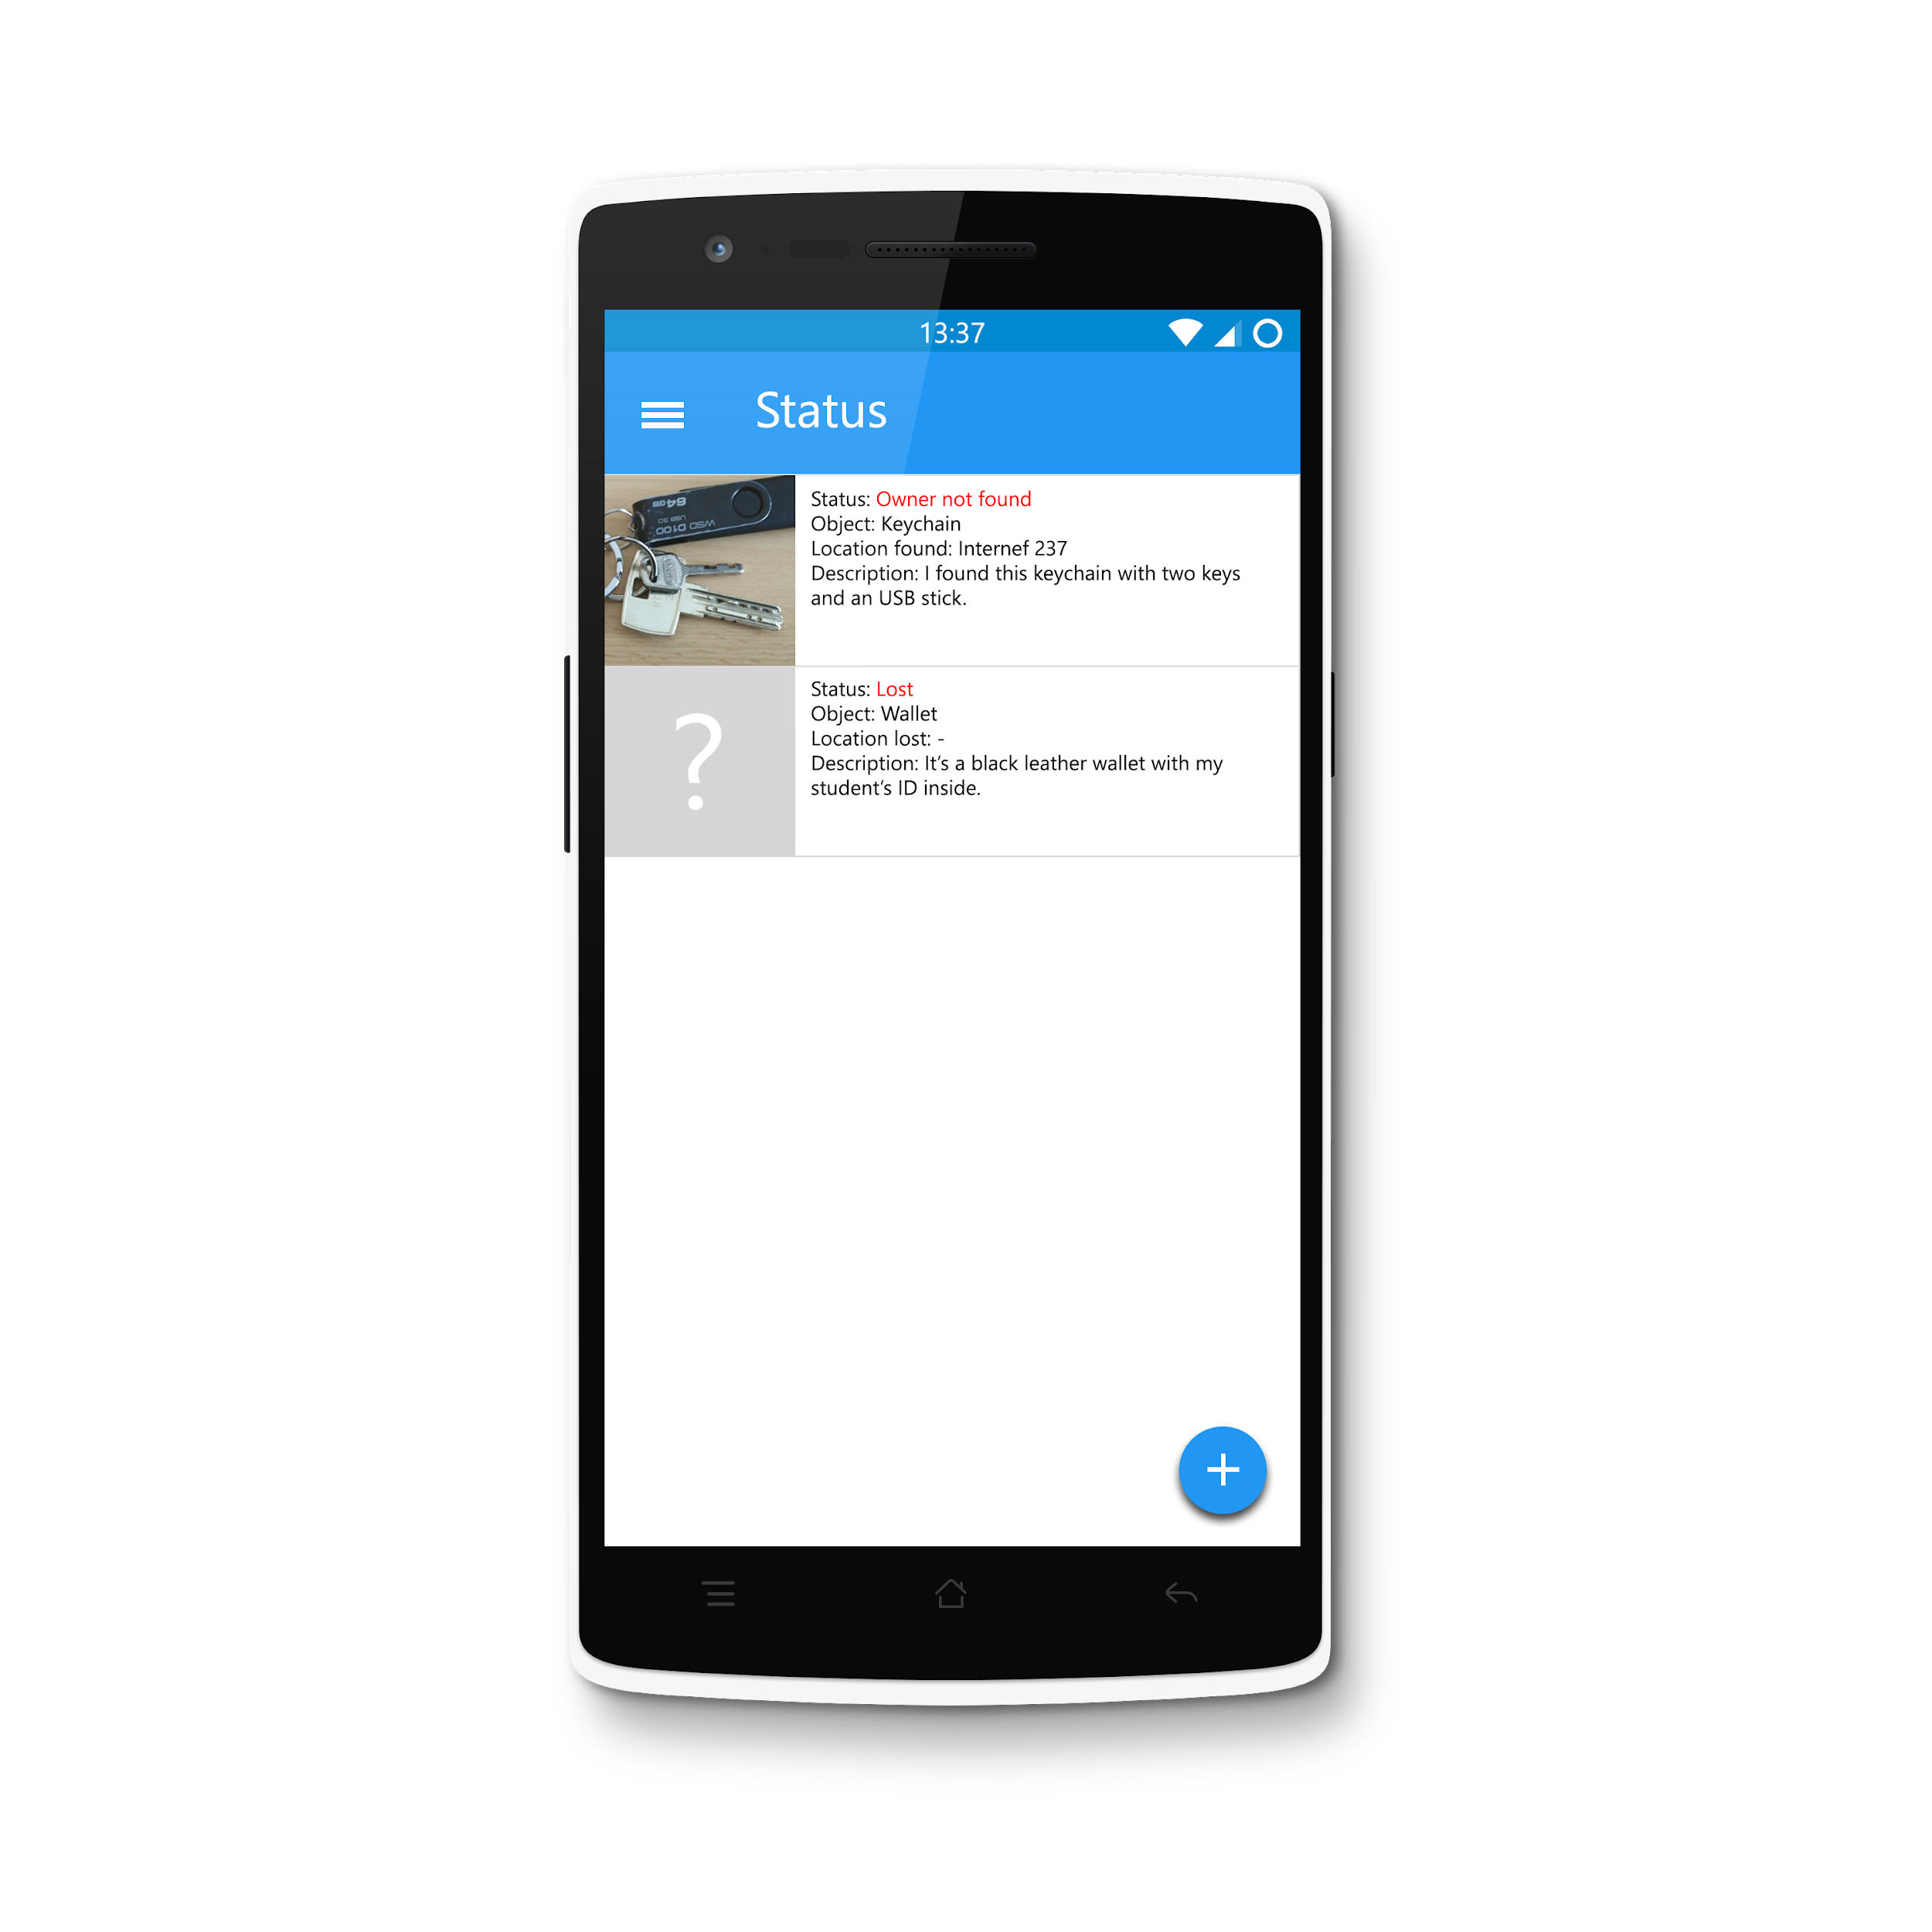
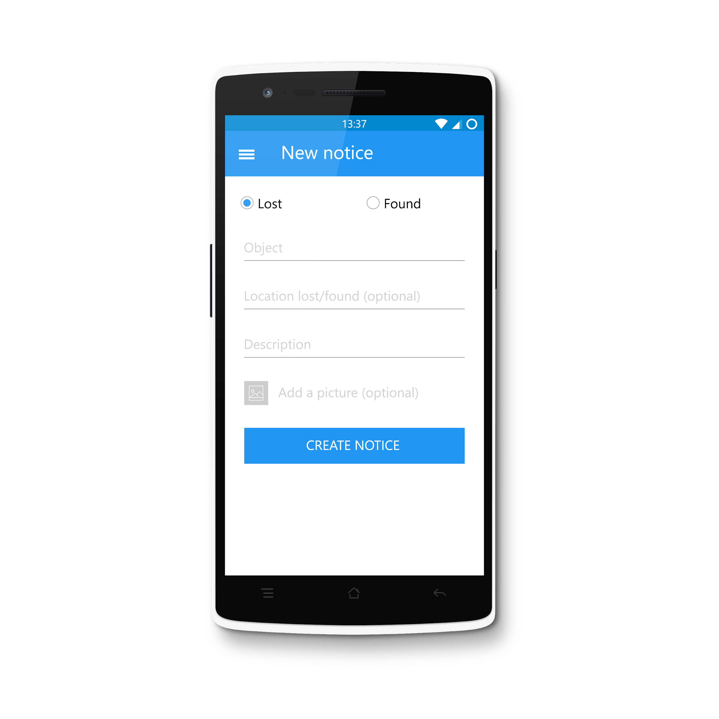
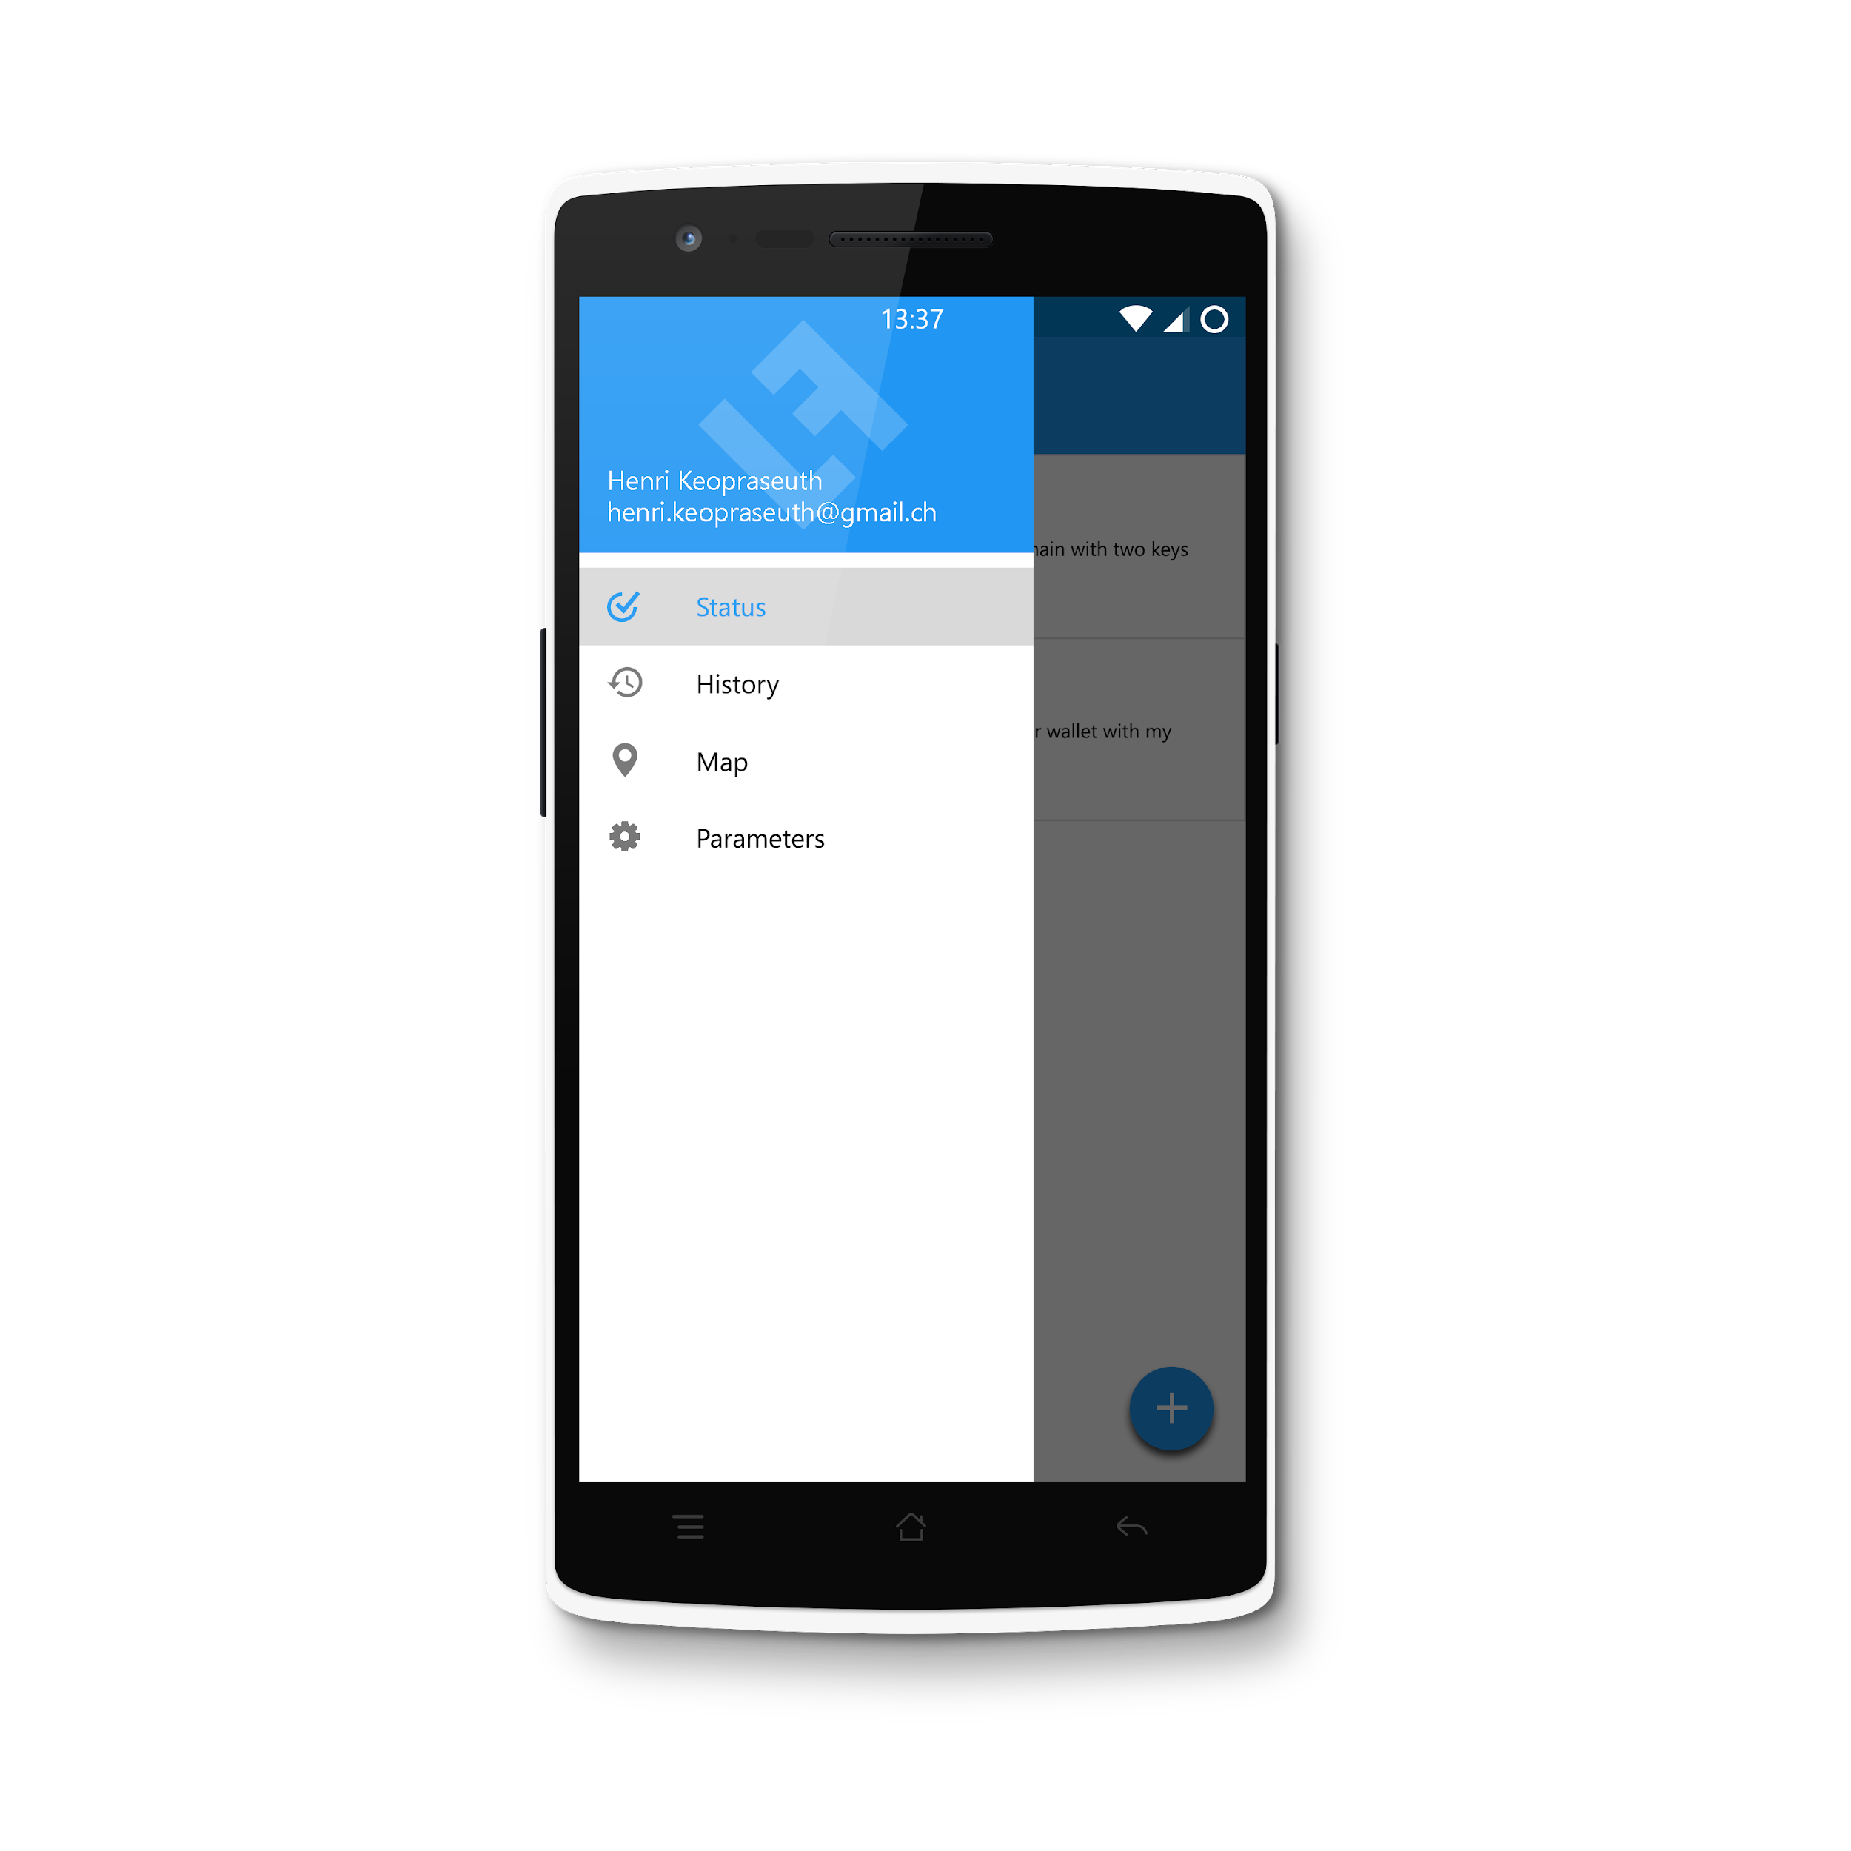
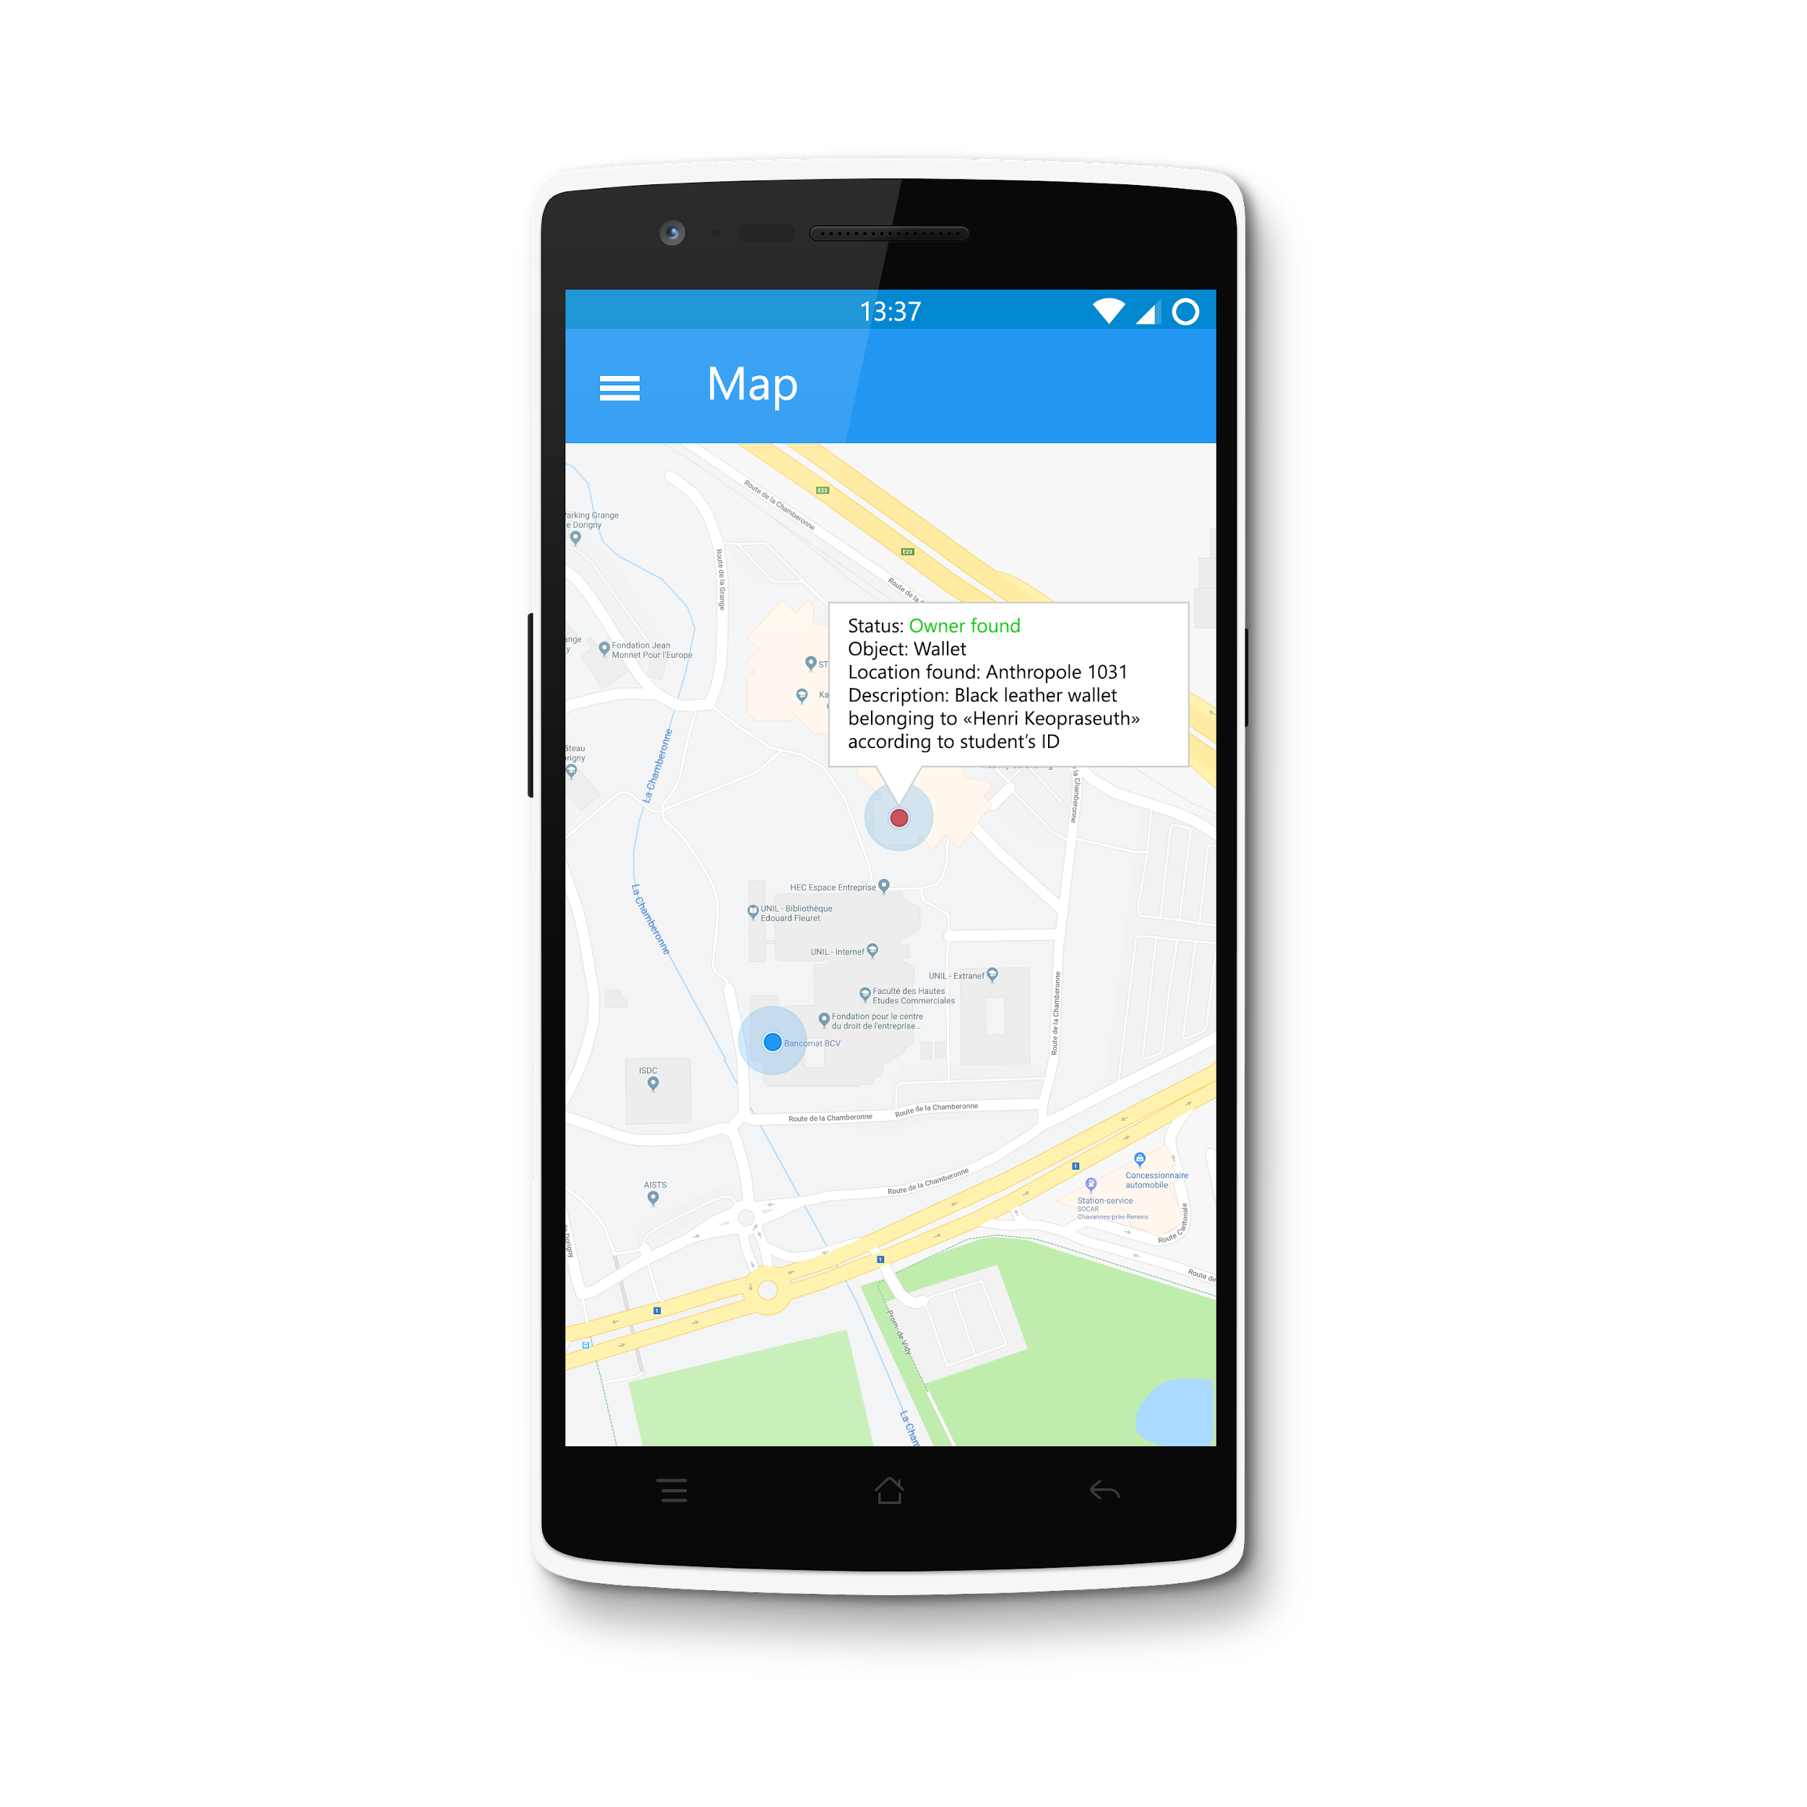
Concept 1
by Henri Keopraseuth

Slide 7
Concept 2
https://pr.to/RKLKKB/
by Aloïs Borgognon

Slide 8
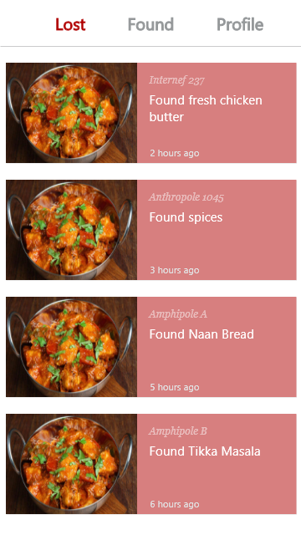
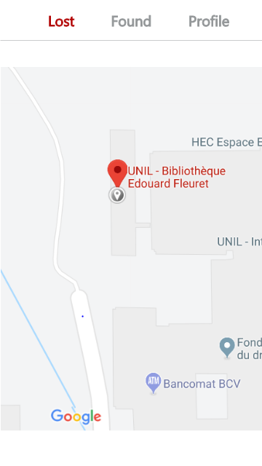
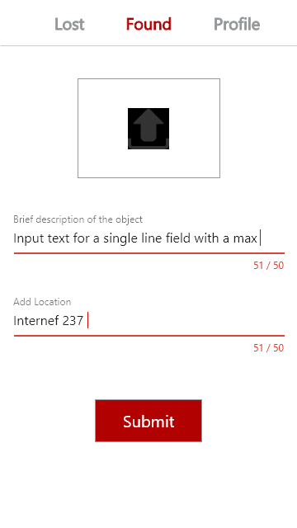
Concept 3
by Samuel Nguyen

Slide 9
Architecture, description and communication between building blocks

Slide 10
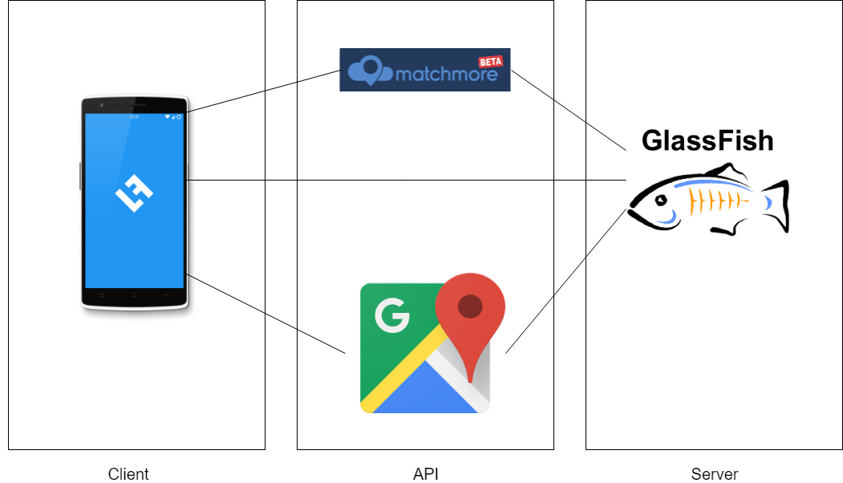
Architecture, description and communication
Development on Android (with Android Studio)
MatchMore API and probably Google Maps API
Backend with GlassFish 5

Slide 11
List of functionalities
Publish a new lost/found item
Check the status of your notices
Track the item (if matched) in real time
Message the person who found your item in-app (not sure yet)

Slide 12
Work distribution
Each member will try to work a bit everywhere, nothing is fixed as we don’t know each other coding capacities

Slide 13
Thanks!
Any questions?

